Slide 1

Stock-Ticker
Team WasserFall
Washington College
Spring 2018

Slide 2

Overview of the Sprint
Focus on the UI
Research the APIs

Slide 3
Formatting
We decide to split our UI into seven parts : title, search bar, result panel, previous/next panel, Time Series button panel, graph panel, and sell/buy panel
Each was integrated into the SearchPage class as a whole using Border Layout.
JLabels were used for testing purposes with any missing panels.

Slide 4
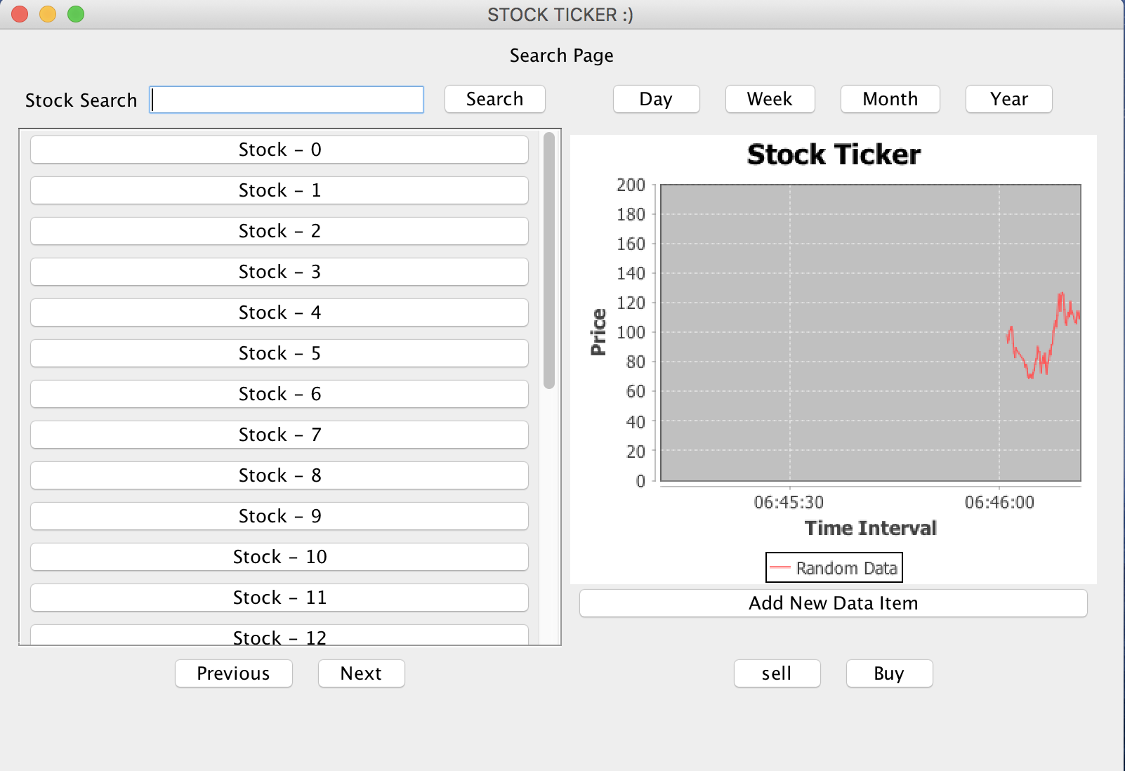
Dynamic Graph
Imports and Implements the jFreeChart library
Able to take data and display them dynamically
Extremely effective to display real-time and especially historical stock prices
Fully integrated into the main UI within a JPanel

Slide 5
Deal Button
Create an Jpanel that name’s dealPanel.
Create two Jbutton that name’s sellButton and buyButton
Add these two Jbutton into the dealPanel.
Finally, add the dealPane into the Jpanel that rightside, and the position is SOUTH
Then, the buy and sell button will show on the bottom of the right side of the frame

Slide 6
Full Demo

Slide 7

Next Sprint
Implementing the backend of the project
APIs: AlpaVantage and Quandl
Make a function a landing page that is password protected
Split the group into two groups

Slide 8
Question

